Slide 1
Sets

Slide 2
Introduction
A set is an unordered collection of objects, called elements or members of the set. A set is said to contain its elements. We write a ∈ A to denote that a is an element of the set A. The notation a ∉ A denotes that a is not an element of the set A. a ∉ A is ¬(a ∈ A)
It is common for sets to be denoted using uppercase letters. Lowercase letters are usually used to denote elements of sets.
There are several ways to describe a set. One way is to list all the members of a set, when this is possible.
We use a notation where all members of the set are listed between braces. For example, the notation {a, b, c, d} represents the set with the four elements a, b, c, and d. This way of describing a set is known as the roster method.

Slide 3
Example
EXAMPLE 1: The set V of all vowels in the English alphabet can be written as V = {a, e, i, o, u}.
EXAMPLE 2: The set O of odd positive integers less than 10 can be expressed by O = {1, 3, 5, 7, 9}.
EXAMPLE 3 : Although sets are usually used to group together elements with common properties, there is nothing that prevents a set from having seemingly unrelated elements.
For instance, {a, 2, Fred, New Jersey} is the set containing the four elements a, 2, Fred, and New Jersey.

Slide 4
Example
Sometimes the roster method is used to describe a set without listing all its members. Some members of the set are listed, and then ellipses (. . .) are used when the general pattern of the elements is obvious.
EXAMPLE 4: The set of positive integers less than 100 can be denoted by {1, 2, 3, . . . , 99}.

Slide 5
Set builder notation
Another way to describe a set is to use set builder notation. We characterize all those elements in the set by stating the property or properties they must have to be members.
For instance, the set O of all odd positive integers less than 10 can be written as
O = {x | x is an odd positive integer less than 10},
or, specifying the universe as the set of positive integers, as
O = {x ∈ Z⁺ | x is odd and x < 10}.

Slide 6
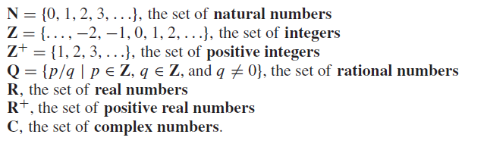
Set builder notation-Continue
We often use this type of notation to describe sets when it is impossible to list all the elements of the set. For instance, the set Q+ of all positive rational numbers can be written as
These sets, each denoted using a boldface letter, play an important role in discrete mathematics:

Slide 7
Notation for intervals of real numbers
When a and b are real numbers with a < b, we write
[a, b] = {x | a ≤ x ≤ b}
[a, b) = {x | a ≤ x < b}
(a, b] = {x |a < x ≤ b}
(a, b) = {x |a < x < b}
Note that [a, b] is called the closed interval from a to b and (a, b) is called the open interval from a to b.

Slide 8
Example
Sets can have other sets as members.
The set {N,Z,Q,R} is a set containing four elements, each of which is a set. The four elements of this set are N, the set of natural numbers; Z, the set of integers; Q, the set of rational numbers; and R, the set of real numbers.

Slide 9
Definition
Two sets are equal if and only if they have the same elements. Therefore, if A and B are sets, then A and B are equal if and only if ∀x(x ∈ A ↔ x ∈ B).We write A = B if A and B are equal sets.
Example
The sets {1, 3, 5} and {3, 5, 1} are equal, because they have the same elements.
Note that the order in which the elements of a set are listed does not matter.
Note also that it does not matter if an element of a set is listed more than once, so {1, 3, 3, 3, 5, 5, 5, 5} is the same as the set {1, 3, 5} because they have the same elements.

Slide 10
The Empty Set
There is a special set that has no elements. This set is called the empty set, or null set, and is denoted by ∅.
The empty set can also be denoted by { } (that is, we represent the empty set with a pair of braces that encloses all the elements in this set).
Often, a set of elements with certain properties turns out to be the null set.
For instance, the set of all positive integers that are greater than their squares is the null set.
Singleton set
A set with one element is called a singleton set. A common error is to confuse the empty set ∅ with the set {∅}, which is a singleton set. The single element of the set {∅} is the empty set itself!

Slide 11
Venn Diagrams
Sets can be represented graphically using Venn diagrams, named after the English mathematician JohnVenn, who introduced their use in 1881.
InVenn diagrams the universal set U, which contains all the objects under consideration, is represented by a rectangle.
Note that the universal set varies depending on which objects are of interest.
Inside this rectangle, circles or other geometrical figures are used to represent sets.
Sometimes points are used to represent the particular elements of the set.
Venn diagrams are often used to indicate the relationships between sets.

Slide 12
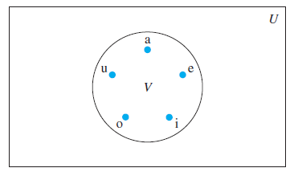
Example
Draw a Venn diagram that represents V, the set of vowels in the English alphabet.
Solution
We draw a rectangle to indicate the universal set U, which is the set of the 26 letters of the English alphabet.
Inside this rectangle we draw a circle to represent V . Inside this circle we indicate the elements of V with points

Slide 13
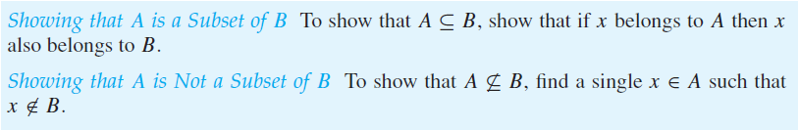
Subsets
The set A is a subset of B if and only if every element of A is also an element of B. We use the notation A ⊆ B to indicate that A is a subset of the set B.
We see that A ⊆ B if and only if the quantification ∀x(x ∈ A → x ∈ B) is true.
Note that to show that A is not a subset of B we need only find one element x ∈ A with x ∉ B.

Slide 14
Example
The set of all odd positive integers less than 10 is a subset of the set of all positive integers less than 10.
The set of rational numbers is a subset of the set of real numbers.
The set of all computer science majors at your school is a subset of the set of all students at your school.
The set of all people in China is a subset of the set of all people in China

Slide 15
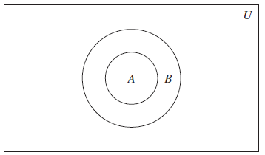
Example
The set of integers with squares less than 100 is not a subset of the set of nonnegative integers because −1 is in the former set [as (−1)² < 100], but not the later set.
The set of people who have taken discrete mathematics at your school is not a subset of the set of all computer science majors at your school if there is at least one student who has taken discrete mathematics who is not a computer science major.
Venn Diagram Showing that A is a subset of B

Slide 16

Proper Subset
When we wish to emphasize that a set A is a subset of a set B but that A ≠ B, we write A ⊂ B and say that A is a proper subset of B.
That is, A is a proper subset of B if and only if
is true.
For example, if A={1,3,5} then B={1,5} is a proper subset of A. Set C={1,3,5} is a subset of A, but it is not a proper subset of A since C=A. The set D={1,4} is not even a subset of A, since 4 is not an element of A.

Slide 17
Equal set
To show that two sets A and B are equal, show that A ⊆ B and B ⊆ A.
Sets may have other sets as members. For instance, we have the sets
A = {∅, {a}, {b}, {a, b}} and B = {x | x is a subset of the set {a, b}}.
Note that these two sets are equal, that is, A = B.

Slide 18
The Size of a set
Let S be a set. If there are exactly n distinct elements in S where n is a nonnegative integer, we say that S is a finite set and that n is the cardinality of S. The cardinality of S is denoted by |S|.
EXAMPLE : Let A be the set of odd positive integers less than 10. Then |A| = 5.
EXAMPLE : Let S be the set of letters in the English alphabet. Then |S| = 26.
EXAMPLE : Because the null set has no elements, it follows that |∅| = 0.

Slide 19
Finite Set
A set is said to be infinite if it is not finite.
EXAMPLE: The set of positive integers is infinite.
Power Set
Given a set S, the power set of S is the set of all subsets of the set S. The power set of S is denoted by P(S).
Example
What is the power set of the set {0, 1, 2}?
Solution
The power set P({0, 1, 2}) is the set of all subsets of {0, 1, 2}. Hence,
P({0, 1, 2}) = {∅, {0}, {1}, {2}, {0, 1}, {0, 2}, {1, 2}, {0, 1, 2}}.

Slide 20
Example
What is the power set of the empty set? What is the power set of the set {∅}?
Solution
The empty set has exactly one subset, namely, itself. Consequently,
P(∅) = {∅}.
The set {∅} has exactly two subsets, namely, ∅ and the set {∅} itself. Therefore,
P({∅}) = {∅, {∅}}.
If a set has n elements, then its power set has 2^{n} elements.

Slide 21
Cartesian product
Let A and B be sets. The Cartesian product of A and B, denoted by A × B, is the set of all ordered pairs (a, b), where a ∈ A and b ∈ B.
Hence, A × B = {(a, b) | a ∈ A ∧ b ∈ B}.
Example
What is the Cartesian product of A = {1, 2} and B = {a, b, c}?
Solution
The Cartesian product A × B is
A × B = {(1, a), (1, b), (1, c), (2, a), (2, b), (2, c)}.
Note:
The Cartesian products A ×B and B × A are not equal, unless A = ∅ or B = ∅ (so that A × B = ∅) or A = B

Slide 22
Example
Show that the Cartesian product B × A is not equal to the Cartesian product A × B, where A = {1, 2} and B = {a, b, c}.
Solution
The Cartesian product B × A is B × A = {(a, 1), (a, 2), (b, 1), (b, 2), (c,1), (c, 2)}.
This is not equal to A × B = {(1, a), (1, b), (1, c), (2, a), (2, b), (2, c)}.

Slide 23
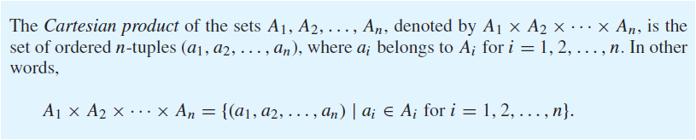
Definition

Slide 24
Example
What is the Cartesian product A × B × C, where A = {0, 1}, B = {1, 2}, and C = {0, 1, 2} ?
Solution
The Cartesian product A × B × C consists of all ordered triples (a, b, c), where a ∈ A, b ∈ B, and c ∈ C. Hence,
A × B × C = {(0, 1, 0), (0, 1, 1), (0, 1, 2), (0, 2, 0), (0, 2, 1), (0, 2, 2),
(1, 1, 0), (1, 1, 1), (1, 1, 2), (1, 2, 0), (1, 2, 1), (1, 2, 2)}.
Remark
Note that when A, B, and C are sets, (A × B) × C is not the same as A ×( B × C)

Slide 25
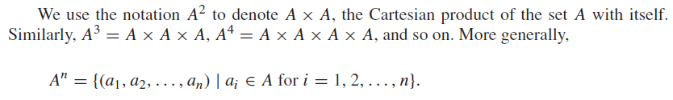
Example
Suppose that A = {1, 2}. It follows that A² = {(1, 1), (1, 2), (2, 1), (2, 2)} and A³ = {(1, 1, 1), (1, 1, 2), (1, 2, 1), (1, 2, 2), (2, 1, 1), (2, 1, 2), (2, 2, 1), (2, 2, 2)}.
Relation
A subset R of the Cartesian product A × B is called a relation from the set A to the set B. The elements of R are ordered pairs, where the first element belongs to A and the second to B.
For example, R = {(a, 0), (a, 1), (a, 3), (b, 1), (b, 2), (c, 0), (c, 3)} is a relation from the set {a, b, c} to the set {0, 1, 2, 3}.

Slide 26
Set Operations
Definition
Let A and B be sets. The union of the sets A and B, denoted by A ∪ B, is the set that contains those elements that are either in A or in B, or in both.
An element x belongs to the union of the sets A and B if and only if x belongs to A or x belongs to B. This tells us that
A ∪ B = {x | x ∈ A ∨ x ∈ B}.
Example
The union of the sets {1, 3, 5} and {1, 2, 3} is the set {1, 2, 3, 5}; that is, {1, 3, 5} ∪ {1, 2, 3} = {1, 2, 3, 5}.

Slide 27
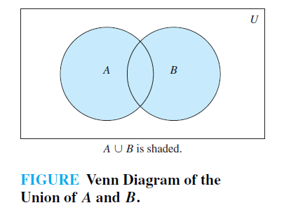
Venn Diagram of Union of two sets A and B
The Venn diagram shown in Figure below represents the union of two sets A and B. The area that represents A ∪ B is the shaded area within either the circle representing A or the circle representing B.

Slide 28
Definition
Let A and B be sets. The intersection of the sets A and B, denoted by A ∩ B, is the set containing those elements in both A and B.
An element x belongs to the intersection of the sets A and B if and only if x belongs to A and x belongs to B. This tells us that
A ∩ B = {x | x ∈ A ∧ x ∈ B}.
Example
The intersection of the sets {1, 3, 5} and {1, 2, 3} is the set {1, 3}; that is, {1, 3, 5} ∩ {1, 2, 3} = {1, 3}.

Slide 29
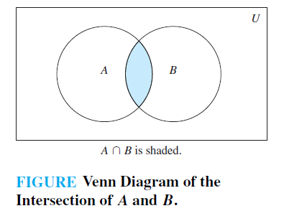
Venn Diagram of Intersection of two sets A and B
The Venn diagram shown in Figure below represents the intersection of two sets A and B. The shaded area that is within both the circles representing the sets A and B is the area that represents the intersection of A and B.

Slide 30
Definition
Two sets are called disjoint if their intersection is the empty set.
Example
Let A = {1, 3, 5, 7, 9} and B = {2, 4, 6, 8, 10}. Because A ∩ B = ∅, A and B are disjoint.

Slide 31
Cardinality of a union of two sets
We are often interested in finding the cardinality of a union of two finite sets A and B. It can be defined as
|A ∪ B| = |A| + |B| − |A ∩ B|.
Definition
Let A and B be sets. The difference of A and B, denoted by A − B, is the set containing those elements that are in A but not in B. The difference of A and B is also called the complement of B with respect to A.

Slide 32

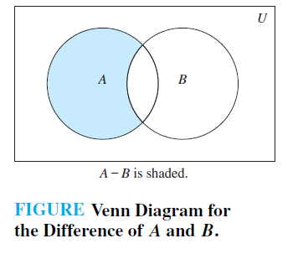
Continue
The difference of sets A and B is sometimes denoted by A\B.
An element x belongs to the difference of A and B if and only if x ∈ A and x ∉ B. This tells us that
The difference of {1, 3, 5} and {1, 2, 3} is the set {5}; that is, {1, 3, 5} − {1, 2, 3} = {5}.
This is different from the difference of {1, 2, 3} and {1, 3, 5}, which is the set {2}.

Slide 33

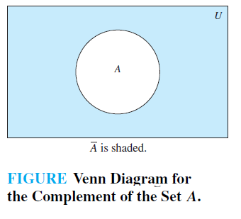
Definition
Let U be the universal set. The complement of the set A, denoted by Ā, is the complement of A with respect to U. Therefore, the complement of the set A is U − A.
An element belongs to Ā if and only if x ∉ A. This tells us that

Slide 34
Example
Let A = {a, e, i, o, u} (where the universal set is the set of letters of the English alphabet). Then Ā = {b, c, d, f, g, h, j, k, l,m, n, p, q, r, s, t, v,w, x, y, z}.
Example
Let A be the set of positive integers greater than 10 (with universal set the set of all positive integers). Then A = {1, 2, 3, 4, 5, 6, 7, 8, 9, 10}.

Slide 35
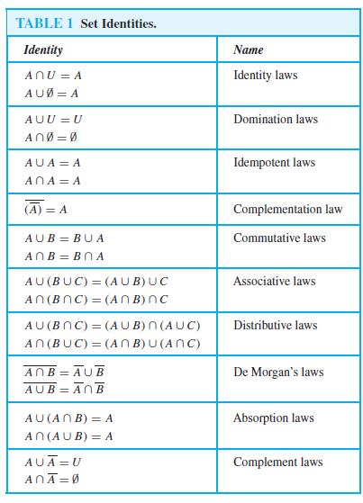
Set Identifiers

Slide 36
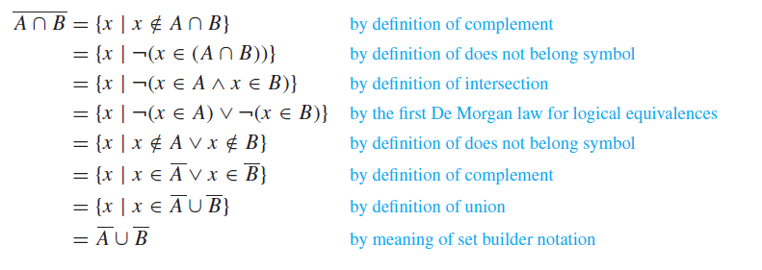
Example
Proof

Slide 37
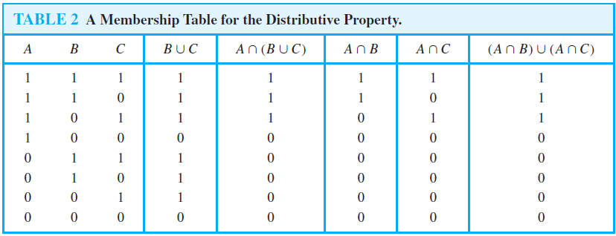
Example
Use a membership table to show that A ∩ (B ∪ C) = (A ∩ B) ∪ (A ∩ C).
Solution

Slide 38

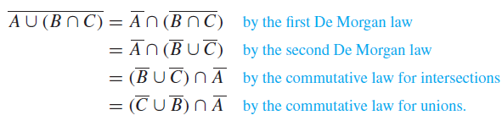
Example
Solution

Slide 39
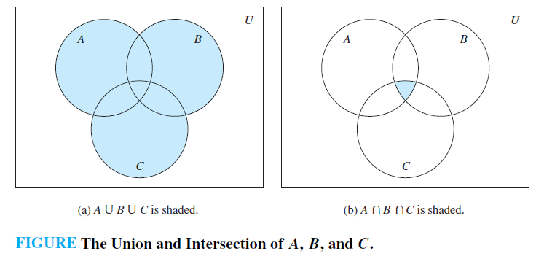
Generalized Unions and Intersections
Because unions and intersections of sets satisfy associative laws, the sets A ∪ B ∪ C and A ∩ B ∩ C are well defined; that is, the meaning of this notation is unambiguous when A, B, and C are sets.
That is, we do not have to use parentheses to indicate which operation comes first because A ∪ (B ∪ C) = (A ∪ B) ∪ C and A ∩ (B ∩ C) = (A ∩ B) ∩ C.
Note that A ∪ B ∪ C contains those elements that are in at least one of the sets A, B, and C, and that A ∩ B ∩ C contains those elements that are in all of A, B, and C.

Slide 40
Example
Let A = {0, 2, 4, 6, 8}, B = {0, 1, 2, 3, 4}, and C = {0, 3, 6, 9}. What are A ∪ B ∪ C and A ∩ B ∩ C?
Solution
The set A ∪ B ∪ C contains those elements in at least one of A, B, and C. Hence, A ∪ B ∪ C = {0, 1, 2, 3, 4, 6, 8, 9}.
The set A ∩ B ∩ C contains those elements in all three of A, B, and C. Thus, A ∩ B ∩ C = {0}.

Slide 41
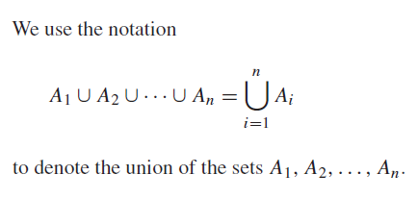
Definition
The union of a collection of sets is the set that contains those elements that are members of at least one set in the collection.

Slide 42
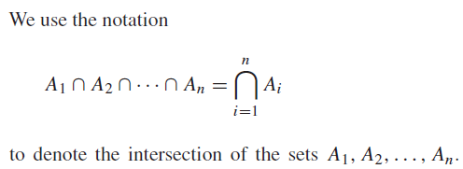
Definition
The intersection of a collection of sets is the set that contains those elements that are members of all the sets in the collection.

Slide 43
END

